Slide 1
k8s

Slide 2
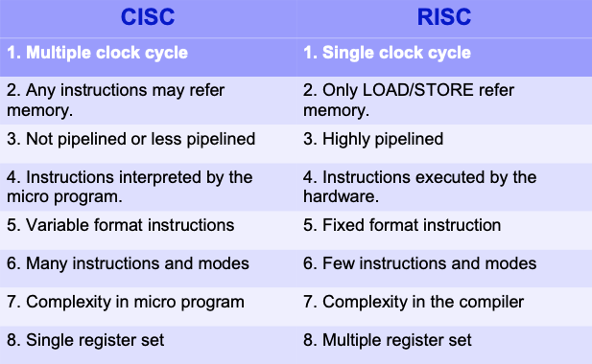
CISC x RISC : Monolith x Microservices?
CISC Effectively realizes one particular High Level Language Computer System in HW
recurring HW development costs when change needed
RISC Allows effective realization of any High Level Language Computer System in SW
recurring SW development costs when change needed

Slide 3
K8S Motivation
The initial goal of this small team was to develop a “minimally viable orchestrator.” From experience we knew that the basic feature set for such an orchestrator was:
Replication to deploy multiple instances of an application
Load balancing and service discovery to route traffic to these replicated containers
Basic health checking and repair to ensure a self-healing system
Scheduling to group many machines into a single pool and distribute work to them

Slide 4
Timeline
2003-2004: Birth of the Borg System: Google introduced the Borg System around 2003-2004. Borg was a large-scale internal cluster management system, which ran hundreds of thousands of jobs, from many thousands of different applications, across many clusters, each with up to tens of thousands of machines.
2013: From Borg to Omega: Following Borg, Google introduced the Omega cluster management system, a flexible, scalable scheduler for large compute clusters.
2014: Google Introduces Kubernetes: Google introduced Kubernetes as an open source version of Borg. Microsoft, RedHat, IBM, Docker joins the Kubernetes community.
2015: The year of Kube v1.0 & CNCF
2016: The Year Kubernetes Goes Mainstream!
2017: The Year of Enterprise Adoption & Support

Slide 5
2018:
March 2: First Beta Version of Kubernetes 1.10 announced. Users could test the production-ready versions of Kubelet TLS Bootstrapping, API aggregation, and more detailed storage metrics.
May 1: Google launches the Kubernetes Podcast, hosted by Craig Box.
May 2-4: KubeCon + CloudNativeCon Europe 2018, hosted in Copenhagen. More than 4,300 developers gathered.
May 21: Google Kubernetes Engine 1.10 is generally available and ready for the enterprise, featuring Shared Virtual Private Cloud, Regional Persistent Disks & Regional Clusters, Node Auto-Repair GA, and Custom Horizontal Pod Autoscaler for greater automation.
May 24: Kubernetes Containerd Integration Goes GA. Containerd 1.1 works with Kubernetes 1.10 and above, and supports all Kubernetes features. The test coverage of containerd integration on Google Cloud Platform in Kubernetes test infrastructure is now equivalent to the Docker integration.
June 5: Amazon EKS Becomes Generally Available. Amazon EKS simplifies the process of building, securing, operating, and maintaining Kubernetes clusters, and brings the benefits of container-based computing to organizations that want to focus on building applications instead of setting up a Kubernetes cluster from scratch.
June 13: The Azure Kubernetes Service (AKS) is generally available. With AKS users can deploy and manage their production Kubernetes apps with the confidence that Azure's engineers are providing constant monitoring, operations, and support for our customers’ fully managed Kubernetes clusters.
June 27: Kubernetes 1.11 announced: In-Cluster Load Balancing and CoreDNS Plugin Graduate to General Availability. This newest version graduates key features in networking, opens up two major features from SIG-API Machinery and SIG-Node for beta testing, and continues to enhance storage features that have been a focal point of the past two releases.

Slide 6
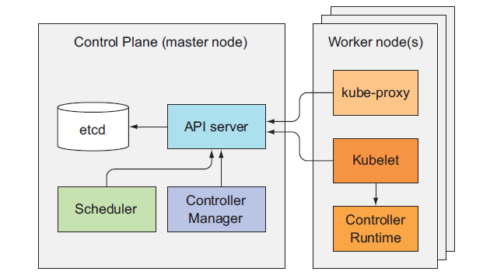
Controller Pattern
In Kubernetes, a controller is a control loop that watches the shared state of the cluster through the API server and makes changes attempting to move the current state towards the desired state. Examples of controllers that ship with Kubernetes today are the replication controller, endpoints controller, namespace controller, and serviceaccounts controller.

Slide 7
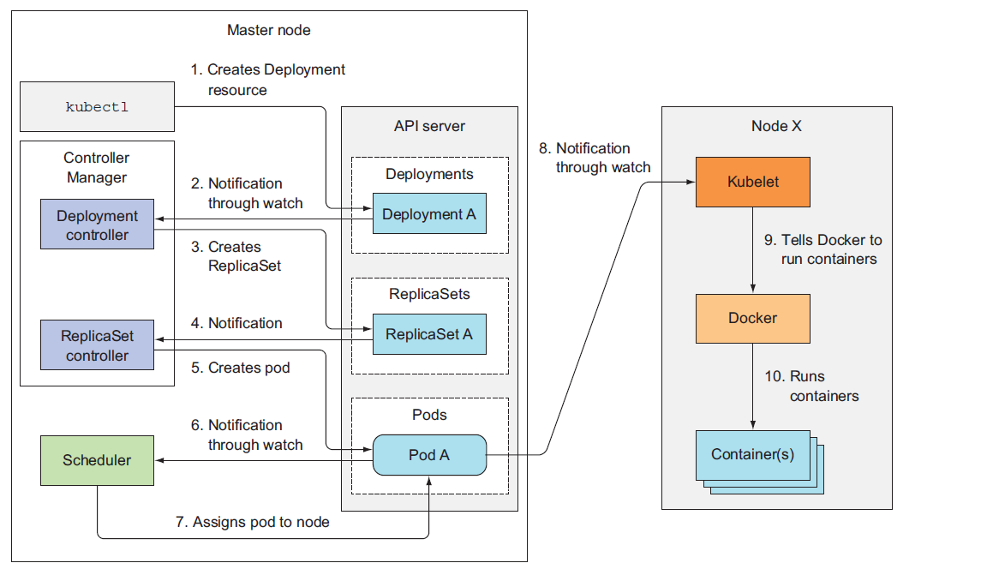
Controller Pattern in Action

Slide 8
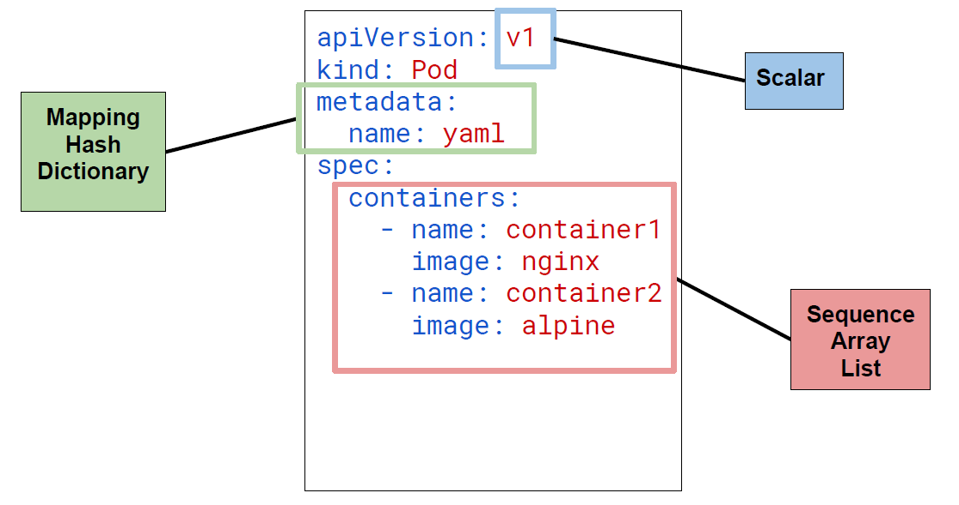
API Driven - Object Model

Slide 9
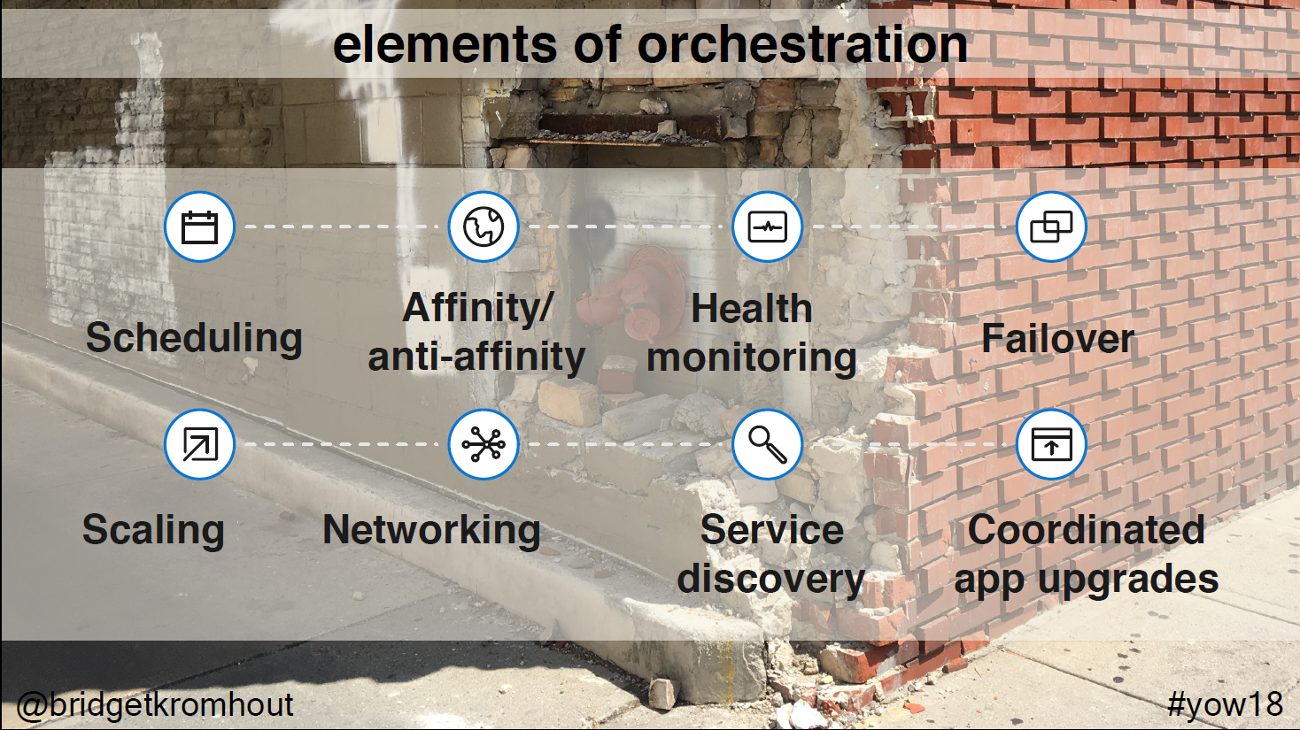

Slide 10
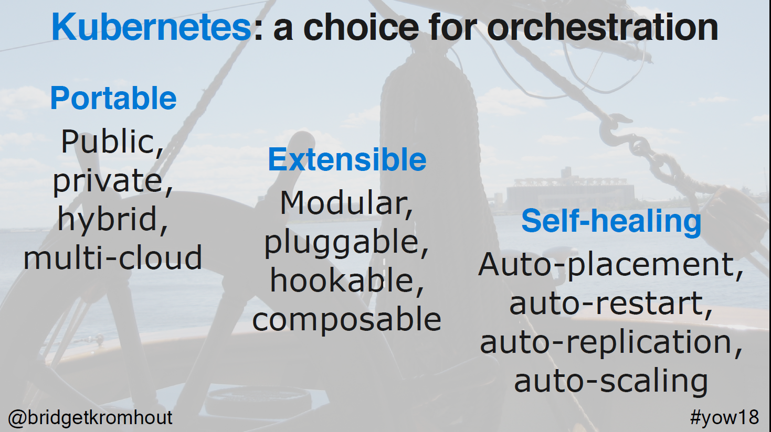

Slide 11
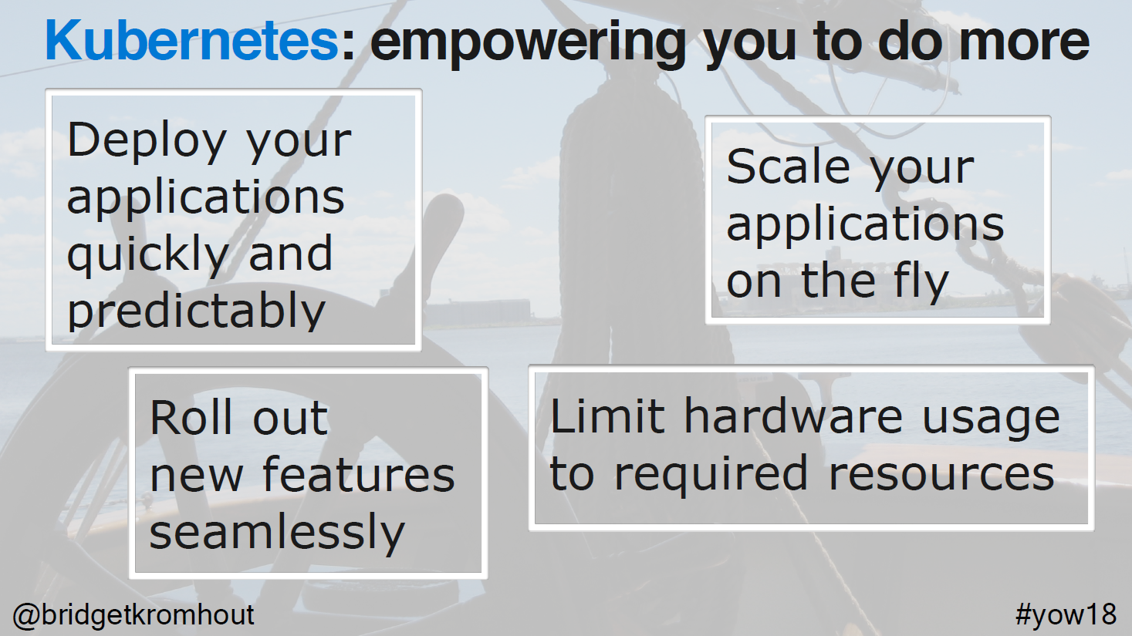

Slide 12
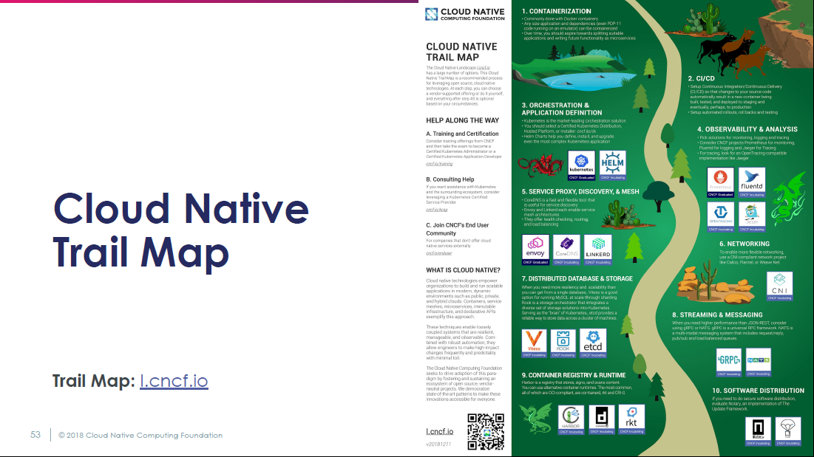

Slide 13
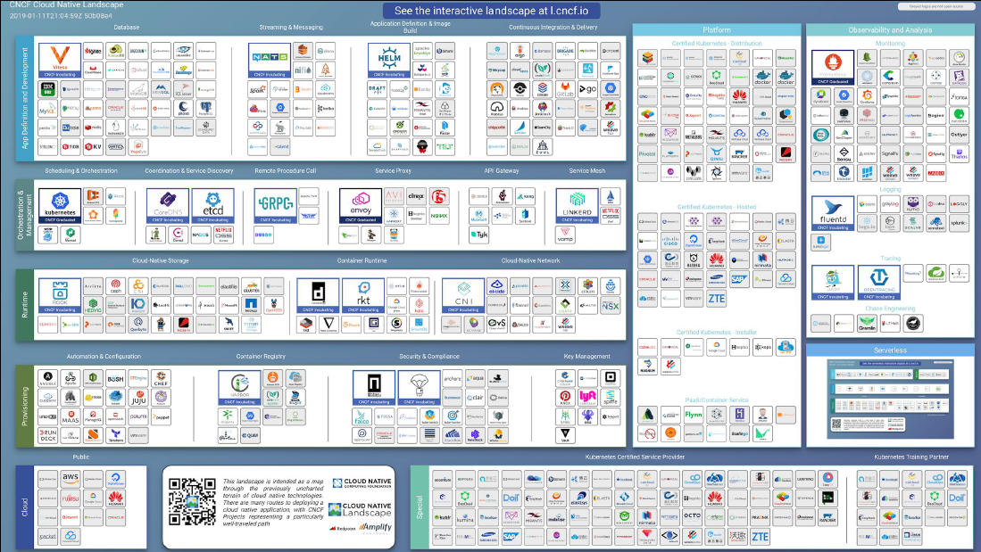

Slide 14
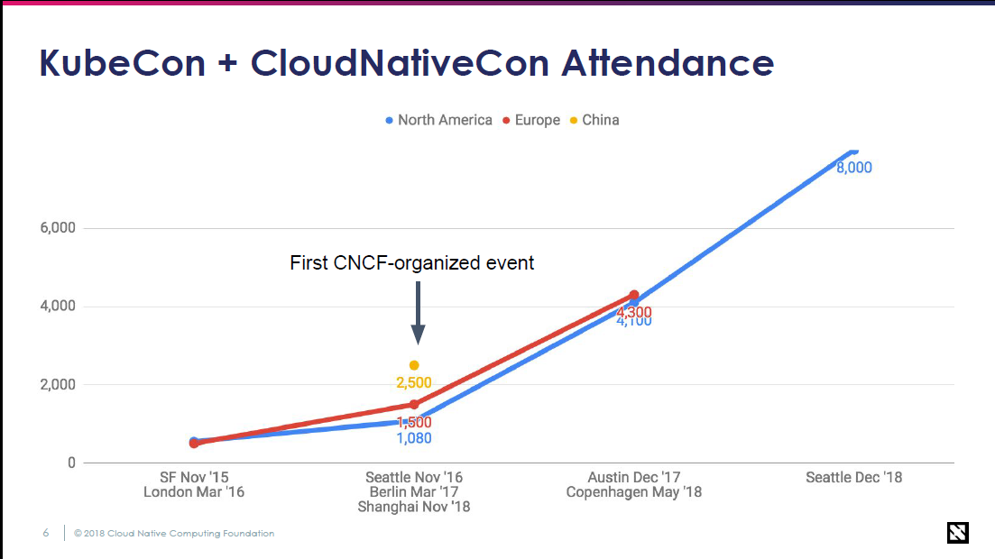

Slide 15
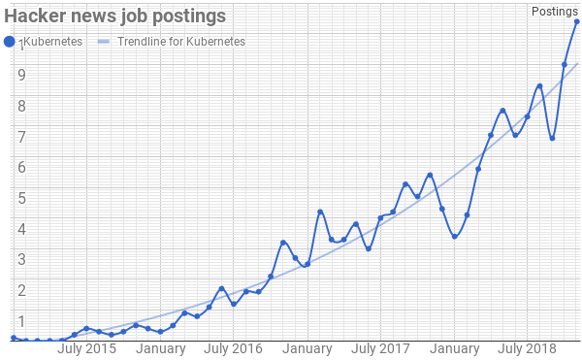
If you still a non-believer ...

